Slide 1
Matrix Operation with C language

Slide 2
Welcome to our Project
The project Submitted to the Institute of Information Technology, Jahangirnagar University, Savar, Dhaka in partial fulfillment of the requirements for the B.Sc (Hons.) degree in IT

Slide 3
SUPERVISED BY
Mrs. Fahima Tabassum
Assistant Professor
Institute of Information Technology
Jahangirnagar University
Savar, Dhaka-1342, Bangladesh

Slide 4
Submitted By: Group B
1.Ratri Saha Mow
Roll-1886
2.Md. Nazmul Islam Akash
Roll-1913
3.Md.Mamun Sarker
Roll-1911
4.Md.Sohel Rana
Roll-1917
5. Methun Roy
Roll-1908

Slide 5
ABSTRACT
A matrix is an ordered set of numbers listed in rectangular form. It is used to solve various types problem in the field of mathematics including Programming. We have built up a programming code to perform different type of operations of matrix including “addition, subtraction, multiplication, transpose, inverse”. This program runs easily according to the instructions given by the users. To build up the program, we include two header files named stdio and stdlib. We made six functions of matrix operations(main, addition, subtraction, transpose, inverse). We use some data types (void, integer) & some variables(i, j, k, temp etc). we also use some keywords(switch, break, case, for, if, else etc).
The function of Matrix’s:
1.Addition of matrix.
2.Subtraction of matrix.
3.Multiplication of matrix.
4.Transpose of matrix.
5.Inverse of matrix.

Slide 6
1.Addition of Matrix
Algorithm:
Step 1: start
Step 2: read the size of matrices A,B – m,n
Step 3: read the elements of matrix A
Step 4: read the elements of matrix B
Step 5: perform the addition operation
Step 6: print sum of matrices A and B
Step 7: Stop

Slide 7
2. Matrix subtraction
Algorthim:
Step 1: start
Step 2: read the size of matrices A,B – m,n
Step 3: read the elements of matrix A
Step 4: read the elements of matrix B
Step 5: perform the subtraction operation
Step 6: print sum of matrices A and B
Step 7: Stop

Slide 8
3.Matrix multiplication
Algorithm:
Step 1: start
Step 2: read the size of matrices A,B
Step 3: check compatibility of matrices for multiplication i.e, number of columns in the first matrix should be equal to number of rows in the second matrix.
Step 4: read the elements of matrix A
Step 5: read the elements of matrix B
Step 6: perform the multiplication operation by storing the resulting values into matrix C.
Step 7: print the resultant matrix C.
Step 8: Stop

Slide 9
4.Matrix transpose
Algorithm:
Step 1: start
Step 2: read the size of matrix A
Step 3: read the elements of matrix A
Step 4: perform the transpose operation by interchanging the row and column values, the order of the resultant matrix number of rows in transpose matrix=number of columns in the given matrix number of columns in transpose matrix=number of rows in the given matrix
Step 5: transpose is obtained through at[i][j]=a[i][j]
Step 6: print the resultant transpose matrix at.
Step 7: stop

Slide 10
5.Matrix Inverse
Algorithm:
Step 1: Start
Step 2: read the size of matrix A
Step 3: read the elements of matrix A
Step 4: perform the transpose operation by interchanging the row and column values, the order of the resultant matrix number of rows in transpose matrix=number of columns in the given matrix number of columns in transpose matrix=number of rows in the given matrix
Step 5: Transpose is obtained through at[i][j]=a[i][j]
Step 6: perform the determine of A matrix
Step 7: Transpose of A matrix is divided by determine of A
Step 8:stop

Slide 11
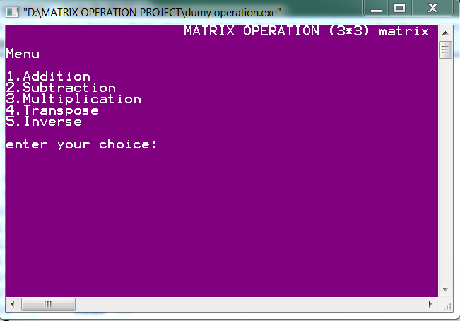
Result: Menu

Slide 12
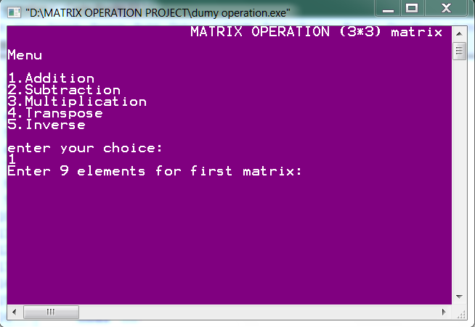
Input

Slide 13
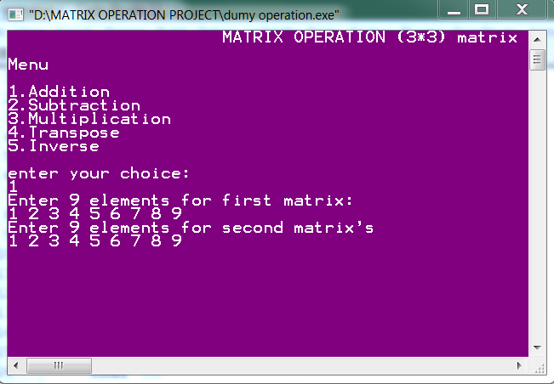
Input

Slide 14
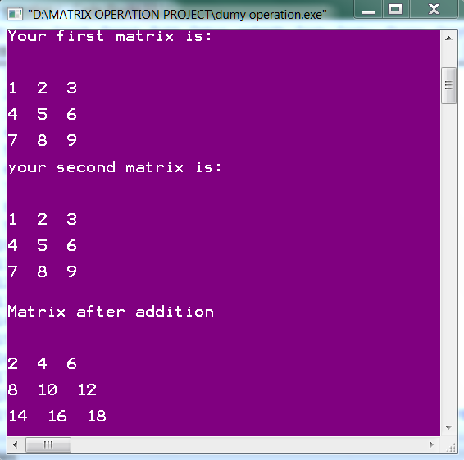
Addition of Matrix

Slide 15
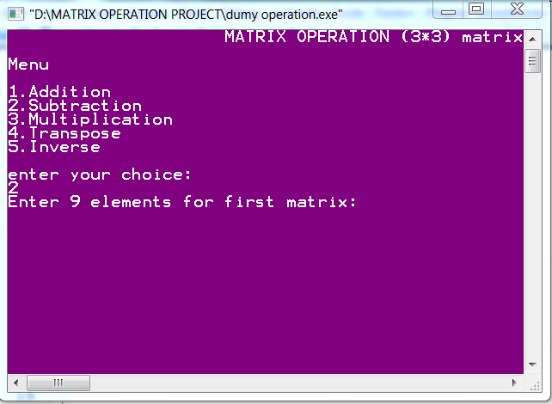

Slide 16
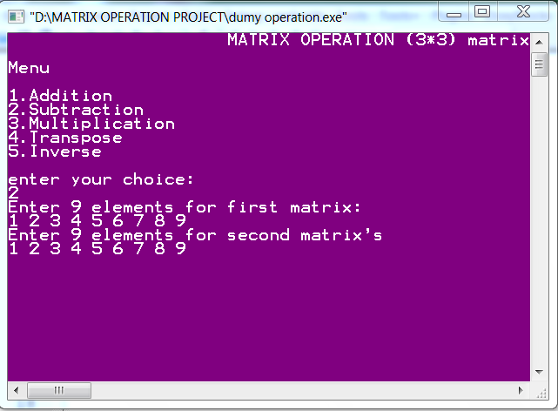

Slide 17
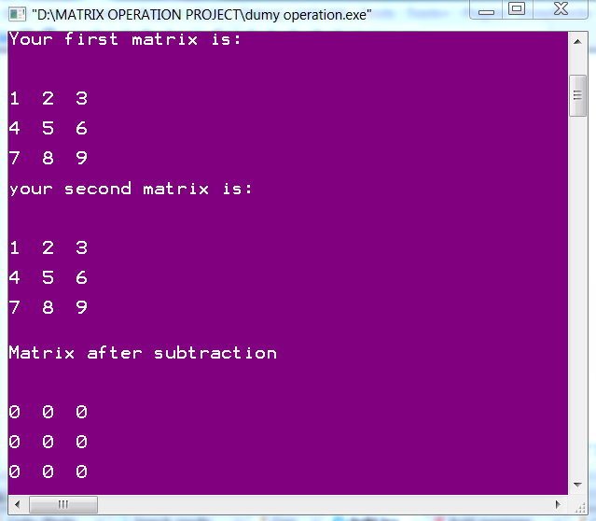
Subtraction of Matrix

Slide 18
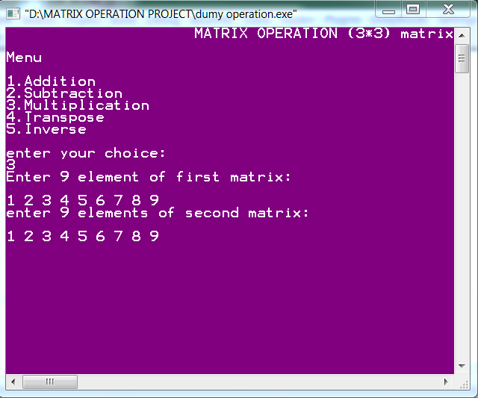

Slide 19
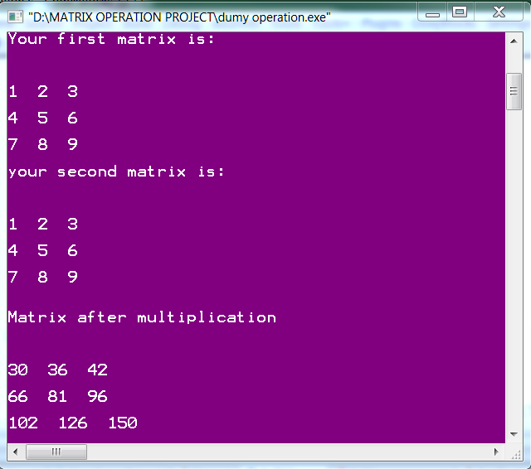
Matrix Multiplication

Slide 20
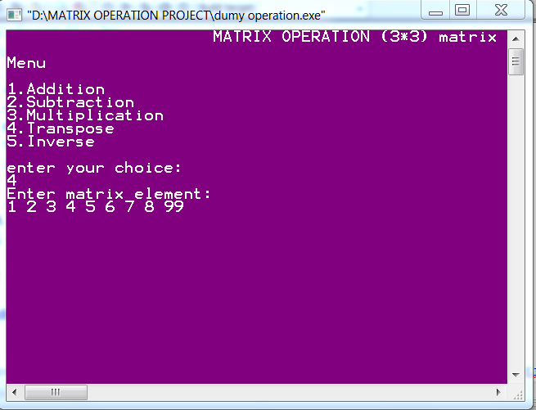
Slide 10

Slide 21
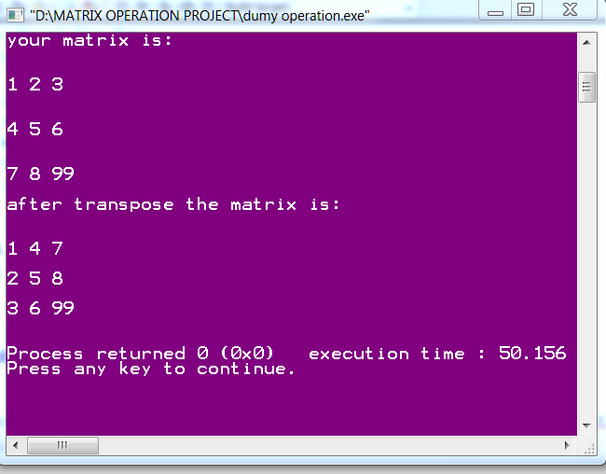
Transpose of Matrix

Slide 22
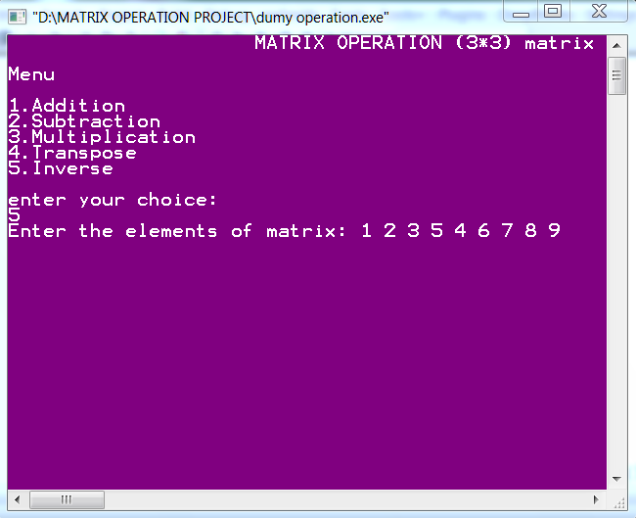
Slide 12

Slide 23
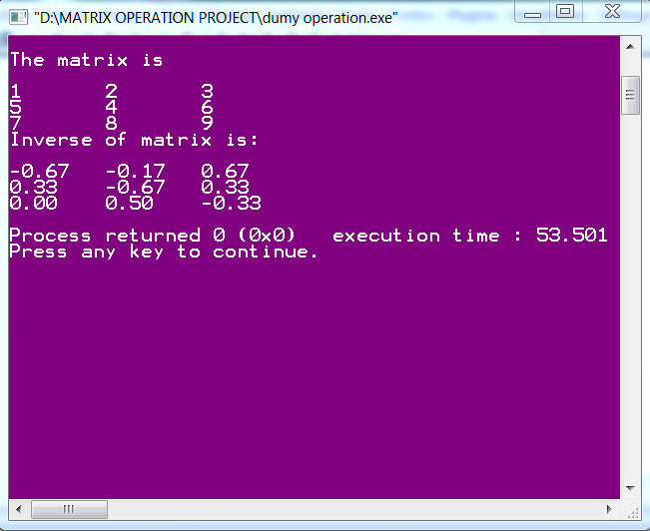
Inverse of Matrix

Slide 24
Conclusion
Our matrix’s Operation Program run smoothly and correctly. We can easily get correct output of user choice through it. We should use this program to get different matrix’s function such as Addition, Subtraction, multiplication, Transpose & Inverse results since the user given instruction. We are able to run matrix operation easily by this Programing code.

